Slide 1
ECOSYSTEM : A
system formed by
the interaction of living
another
organisms with one
&
with their environment.
Eg. : | forest, | grassland, | pond,
field, | river, | lake & sea
Consist of 2 abiotic
components :
components
(non- & biotic
living components)
components
(living
components)

Slide 2
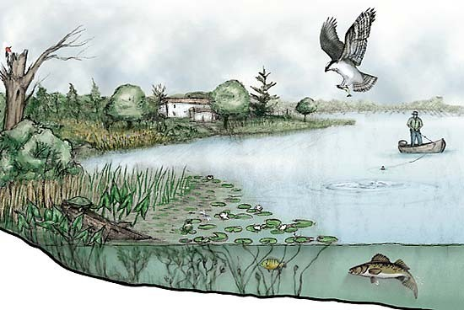

Slide 3
ABIOTIC COMPONENTS OF AN ECOSYSTEM
Physical factors such as pH level, temperature, light intensity, humidity, topography, microclimate & the edaphic factor (physical @ chemical composition of the soil)
All these factors affect the lives & distribution of organisms.

Slide 4
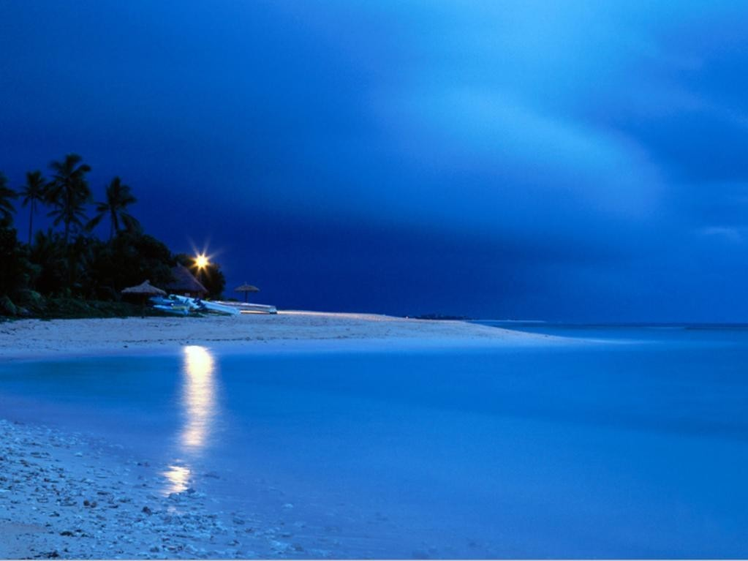
The pH value of the soil & water affects the distribution of organism
Most organisms live in a neutral @ nearly neutral environment (pH6-7.5)
Maize, pineapple, grows well in acidic condition, coconuts grow well in an alkaline condition

Slide 5
Temperature affects the biochemical rxns in the organism
Poikilotherms – cannot control their body temp., their body temp. varies with the environmental temperature.
Homoiotherms – can maintain their body temp. more widespread
Plants & animals have specific characteristics to help them adapt to areas of extreme temperature.

Slide 6
Light
intensity affects
the rate
of photosynthesis
The distribution of more extensive in
green
plants
will be
areas
with
higher
light
intensity
All organisms dark
that live in the soil prefer a
environment
Humidity of
air
affects (plants) &
the rate
of transpiration
the rate
of water evaporation (animals)
Some organisms can control
(have an
extensive distribution), some
cannot
control
such as more
frog, snails, earthworms
& moss are
suited to live in damp places

Slide 7
Topography → shape of the earth’s surface
Altitude –high, less organisms → temp, atmospheric pressure & air humidity are low. Different plants are found at different altitudes
Gradient/slope – affect the rate of water flow. In steep areas, the swift flow of water causes soil erosion. Flat areas, the water is stagnant → both not suitable for plants & animals
Aspect – the direct facing or opposing the wind & sunlight. Areas facing not suitable, less organisms.

Slide 8
Microclimate →the climate in a small habitat (climate in soil, climate below tree trunk)
Has specific temperature, humidity, & light intensity

Slide 9
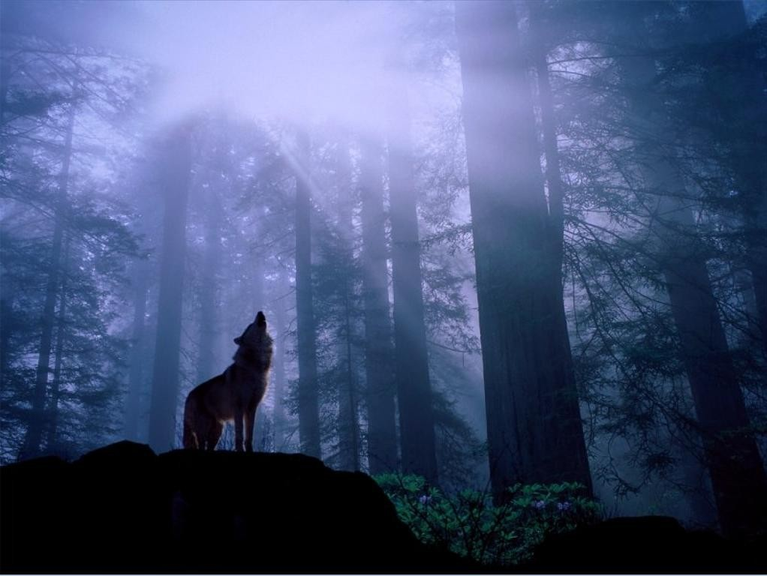
Biotic Components of an Ecosystem
The living organisms in the ecosystem
3
groups – producers, consumers &
decomposers
Producers → green plants, can carry
out photosynthesis to produce
food other
Consumers → feed on plants @ organisms (1º - herbivores,
₂o
-
₃o
→ bacteria & fungi that
carnivores,
Decomposers
–carnivores/omnivores)
break down dead plants & dead animals into simple substances

Slide 10
A feeding relationship between the biotic components → food chain → obtain energy
Each level of food chain → trophic level Grass → grasshopper → frog → snake
(producer)
1st trophic level trophic level
(1º)
2nd trophic level
(2º)
3rd trophic level
(3º)
₄th
Several food chain interact to form a network → food web → energy transferred from 1 trophic to another trophic level

Slide 11
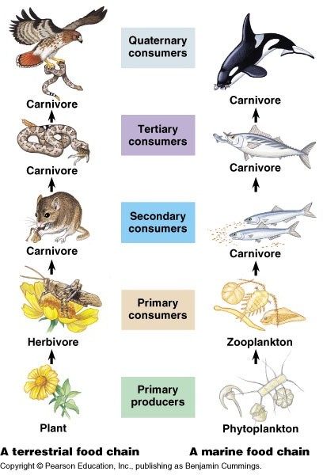

Slide 12
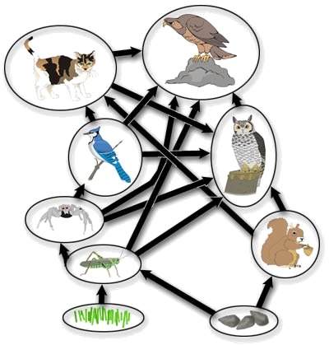
Energy from sunlight
90% energy is lost
Green plants
Producer (900 kJ)
90% energy is lost
Grasshopper
1º (90 kJ)
90% energy is lost
Bird
2º (9 kJ)
90% energy is lost
Eagle
3º (0.9 kJ)

Slide 13
The numbers of organisms in each level in a food chain can be represented by a pyramids of numbers.
The 1st trophic level (producer) at the base of the pyramid

Slide 14
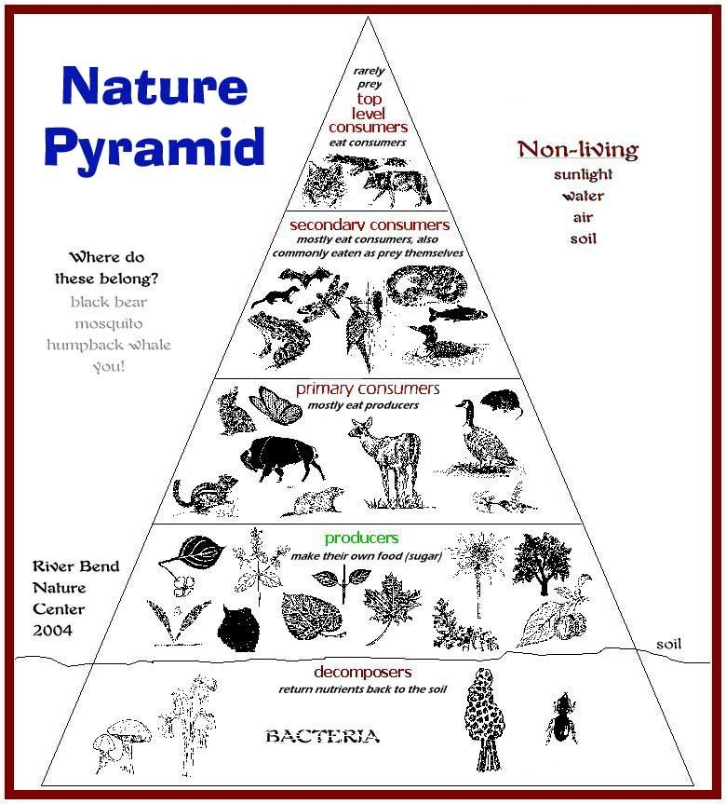

Slide 15
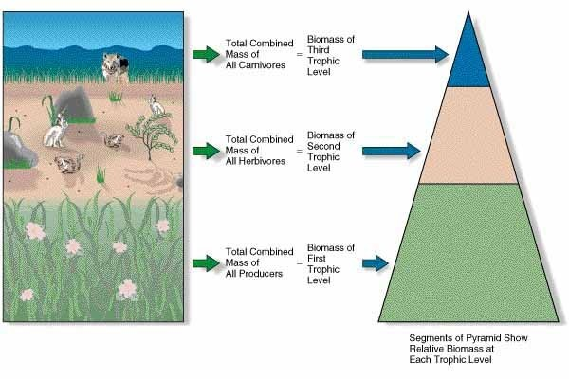

Slide 16
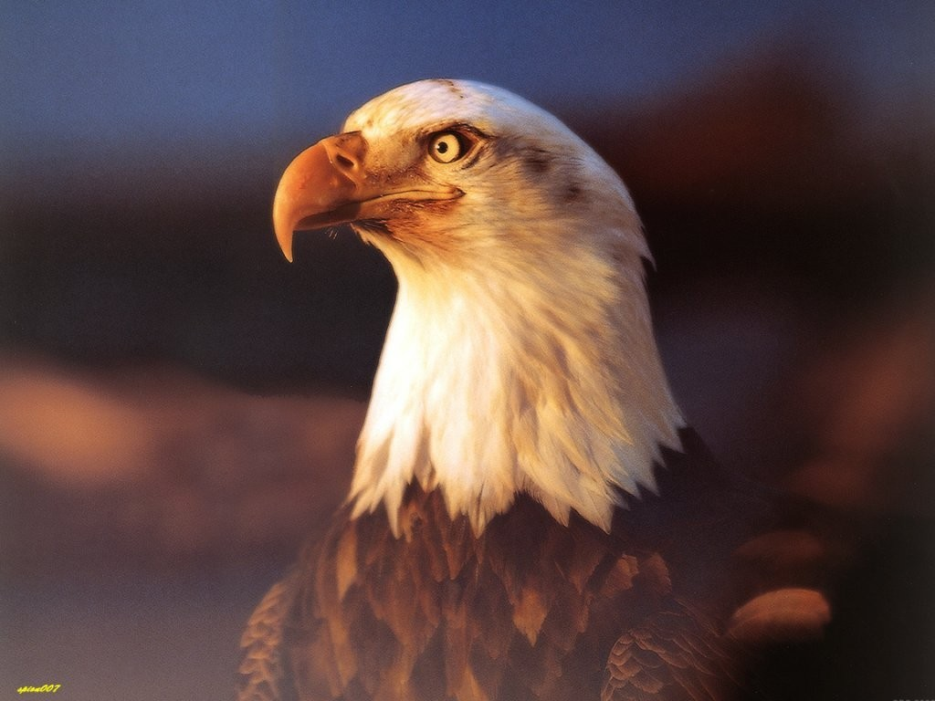
Interaction
between
Biotic Components
in
Relation to Feeding
Symbiosis
An interaction between two organisms of different species that live together
Three types :
Commensalism (commensal receive benefits, host neither received benefit nor harmed)
Parasitism (parasite receive benefits, host is harmed)
Mutualism (both side receive benefits)

Slide 17

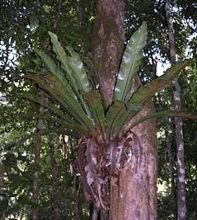
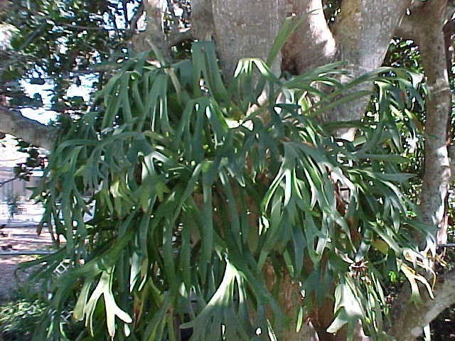

Commensali
sm
•
An interaction between two different organisms where only one organism benefits from the relationship. The other organisms neither benefits nor is harmed.
Commensal – host
Epiphytes – green plants which grow on other plants to obtain more sunlight & for support
Example : pigeon orchid, staghorn fern, birds nest fern, money plant
•
•
•

Slide 18
Epizoites – animals that live on the external surface of another animal
Benefit for commensal – transport, protection, leftover food from the mouth of the host
Examples : remora fish – shark, protozoa – Cyclops sp. (water flea), barnacles – shells of crabs / snails

Slide 19
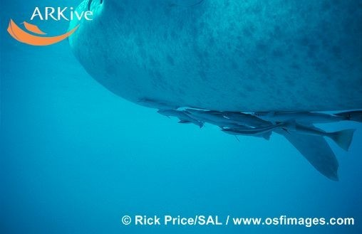

Slide 20
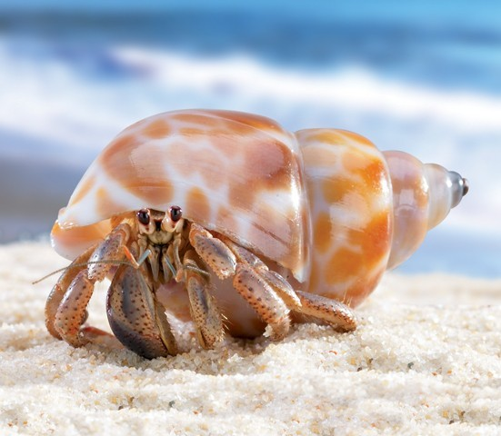

Slide 21
PARASITISM
An interaction between two different
organisms benefits harmed
where one & the other
organism (parasite) organism (host) is
2
types : ectoparasite – live on the
external body surface,
endoparasites –
live in the body of the host
Ectoparasites
depend on their host for
food, protection & transportation.
Examples : flea, lice that
feed on the
blood of the host. Barnacles &
aphids cell sap
(ectoparasites on plants), suck
from plants

Slide 22
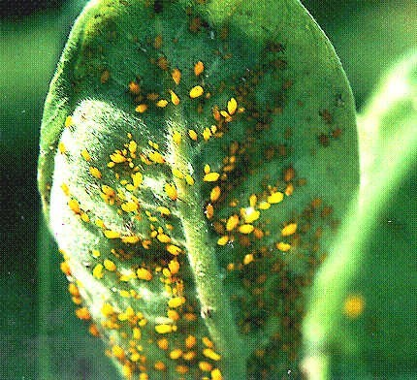
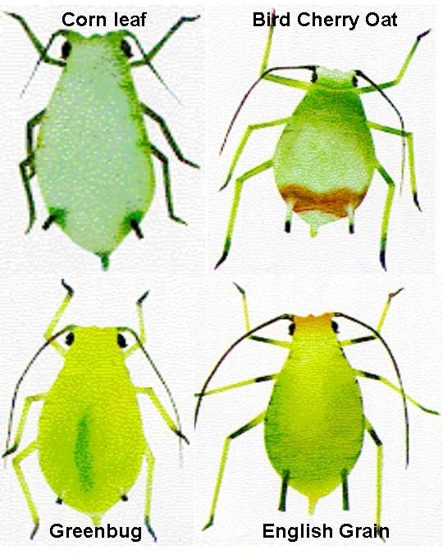
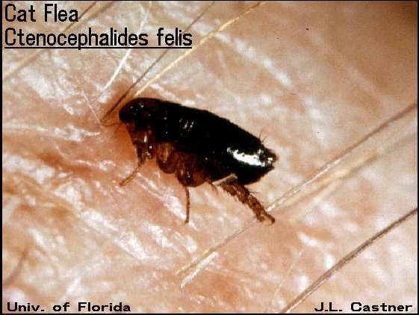

Slide 23
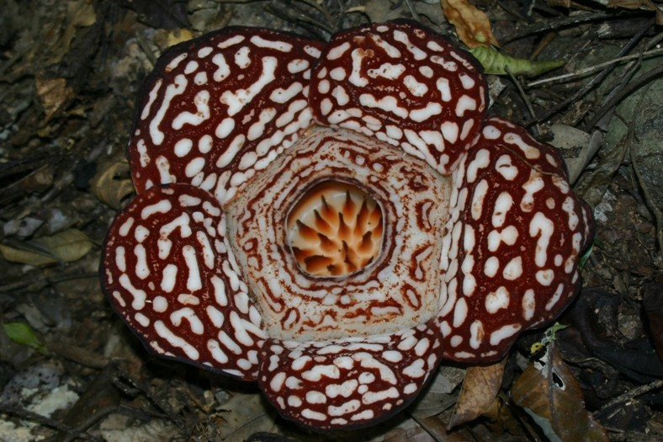
Endoparasites are the various types of worms that live in the alimentary canals of their host & absorb nutrients from the intestines such as tapeworm
Parasitic plant – Rafflesia sp.

Slide 24
MUTUALISM
The interaction between two organism in which both organisms benefit
Examples :
algae (obtain water, minerals & protection) & fungi (obtain food) in lichen (both plants)
Hermit crabs (obtain protection from its predator) & sea anemones (obtain transport & leftover food) (both animals)
Rhizobium bacteria (fix nitrogen in the atmosphere → nitrate) & legume plants (provides food & protection) (one animal & one plant)
Bacteria & protozoa in the alimentary canal of herbivores

Slide 25
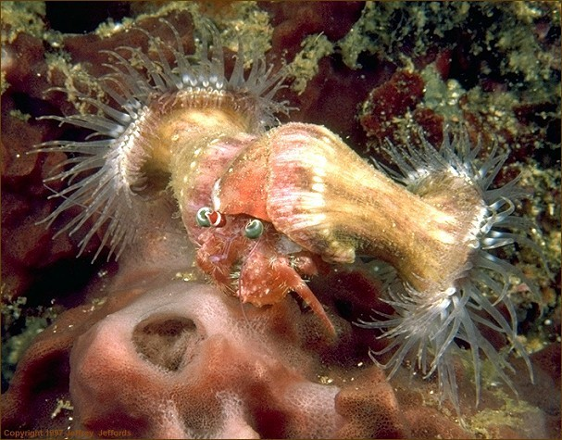

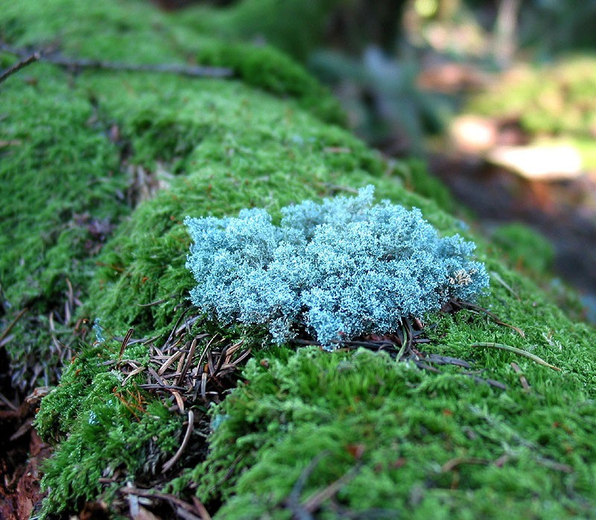


Slide 26
SAPROPHYTISM
An interaction whereby an
on
organism lives & feeds decaying
organic matter
:
Two types
– Saprophytes :
plant (types of
fungi – mushroom, bread mould, bracket fungus)
– Saprozoits : microscopic animals (Paramecium sp. & Amoeba sp.)

Slide 27
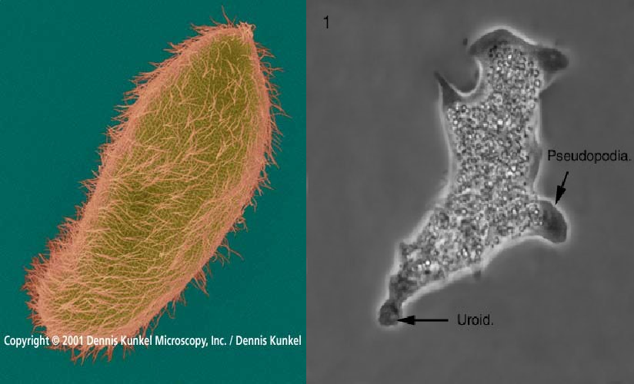

Slide 28
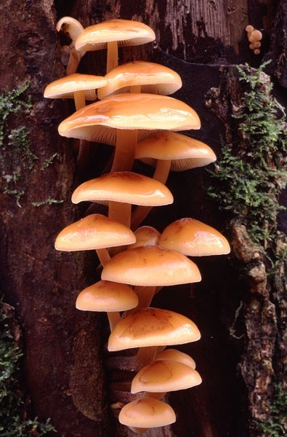
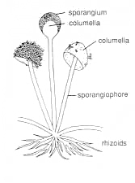
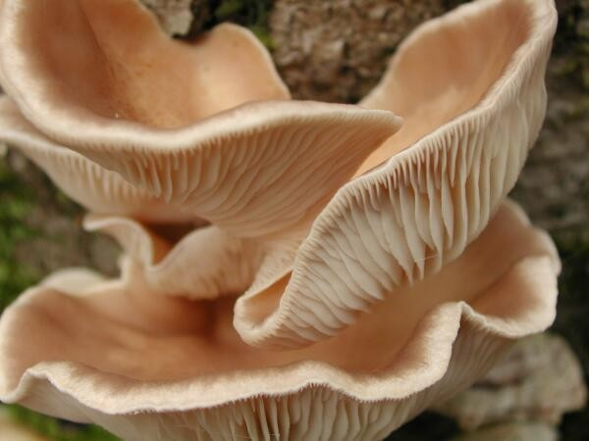
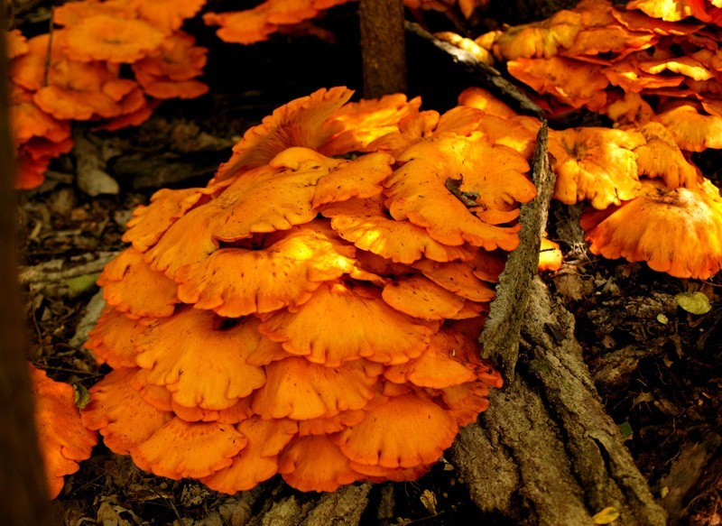

Slide 29
PREY-PREDATOR INTERACTION
An interaction between two population of organisms in which 1 organism (predator), hunts, captures & kills the other organisms (prey), for food
Size of prey is usually smaller than the predator, but the number of prey is always more than the predator

Slide 30
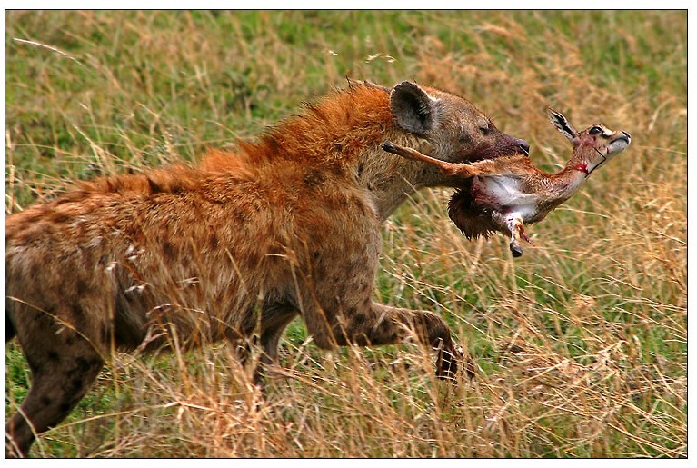
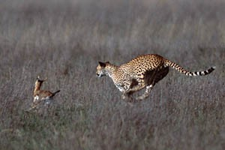
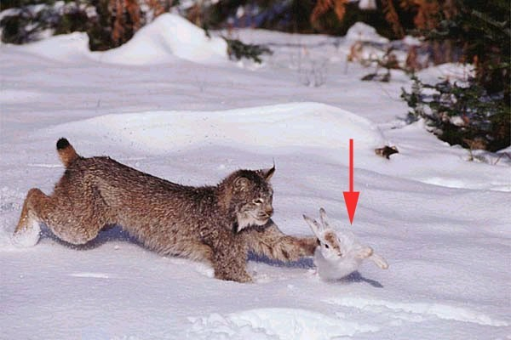

Slide 31
INTERACTION BETWEEN BIOTIC COMPONENTS IN RELATION TO COMPETITION
The interaction between 2 organism @ 2 population to obtain the common basic needs of life that are limited (space, water, minerals, sunlight, food & mates)
Two types : intraspecific & interspecific competition
Intraspecific competition : same species
– Maize plants, seedlings, Paramecium aurelia

Slide 32
Interspecific competition :
different
Stronger
species
species will survive
Paramecium
Maize & paddy
aurelia
plants,
& Paramecium caudatum

